Slide 1
Programmable Quantum Simulators and Sensors on Atomic Platforms
Rick van Bijnen
Institute for Quantum Optics and Quantum Information
Austria, Innsbruck
UQUAM
ERC Synergy Grant
PQC Paris – 29 / 11 / 2019
UNIVERSITY OF INNSBRUCK

Slide 2
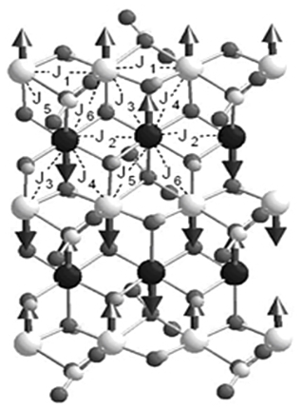
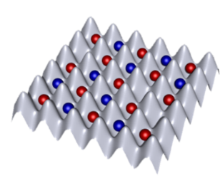
Quantum Simulation
X
Feynman: “a quantum for a quantum”

Slide 3
Outline
Quantum simulation platforms
→ Optical lattices, Rydberg tweezers, ion traps
Variational ground states with 20 ions
3) Verification
4) Summary & Outlook

Slide 4
Optical Lattices
Jaksch, PRL, 81, 3108 (1998)
Greiner et al., Nature (2002)

Slide 5
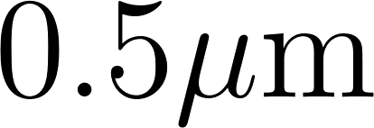
Optical Lattices
→ Mimics electrons hopping in a solid
Jaksch, PRL, 81, 3108 (1998)
Greiner et al., Nature (2002)

Slide 6
Optical Lattices
J. F. Sherson et al.,
Nature 467, 68 (2010)
Slide courtesy of M. Greiner, Harvard

Slide 7
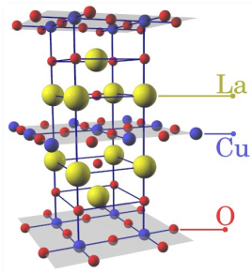
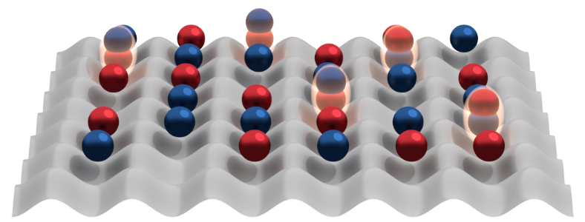
Fermi-Hubbard model
“Strange metal”
P.W. Anderson:
minimal model for cuprate superconductors
Temperature
“Pseudo-
gap” phase
AF
Fermi liquid
d-wave SF (?)
Hole doping
Since 2016: Microscopy of
Fermionic Many-body states
Greif et al., Science 351, 953 (2016)
Cheuk et al., PRL 116, 235301 (2016)
Parsons et al., Science 353, 1253 (2016)
Boll et al., Science 353, 1257 (2016)
Cheuk et al., Science 353, 1260 (2016)
Drewes et al., PRL 118, 170401 (2017)
Brown et al., Science 357, 1385 (2017)
Mitra et al., Nature Physics 14, 173 (2017)
…
2013: Antiferromagnetic correlations
Greif, et al. Science, 340, 1307 (2013)
Hart, et al. Nature, 519, 211 (2015)
Murmann et al., PRL 115, 215301 (2015)
2015: Fermi gas microscopy
Haller et al., Nature Physics 11, 738 (2015)
Cheuk et al., PRL 114, 193001 (2015)
Parsons et al., PRL 114, 213002 (2015)
Edge et al., PRA 92, 063406 (2015)
Omran et al., PRL 115, 263001 (2015)
…

Slide 8
Outline
Quantum simulation platforms
→ Optical lattices, Rydberg tweezers, ion traps
Variational ground states with 20 ions
3) Verification
4) Summary & Outlook

Slide 9
Quantum Simulation

Slide 10
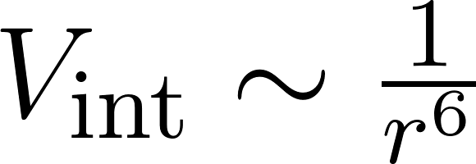
Rydberg excitations

Slide 11
Rydberg blockade
~ GHz
no longer resonant!
Jaksch et al., PRL 85, 2208 (2000)
Lukin et al., PRL 87, 037901 (2001)

Slide 12
Rydberg Tweezers

Slide 13
Rydberg Tweezers
→ Realises quantum simulation of long-range Ising model
→ MHz ~ GHz interaction strengths
→ Coherence times of 100s of microseconds
→ More exotic interactions possible
→ Arbitrary geometries

Slide 14
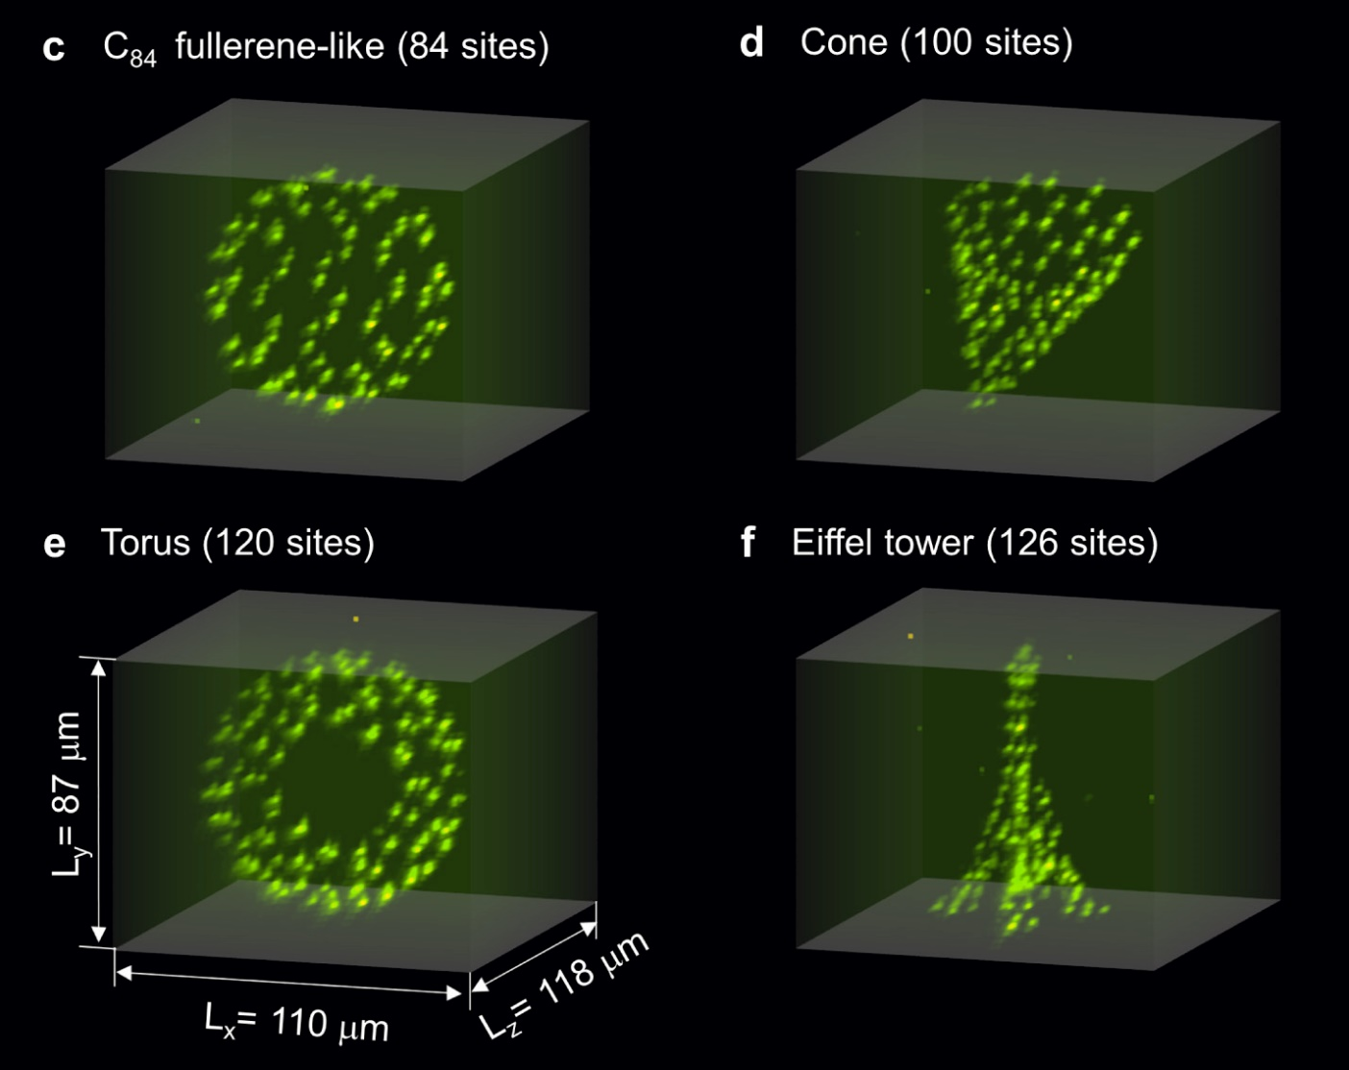
Rydberg Tweezers
D. Barredo et al., Nature 561, 79 (2018)

Slide 15
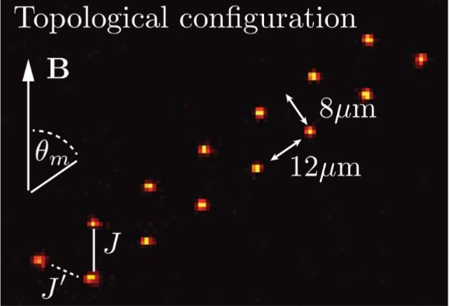
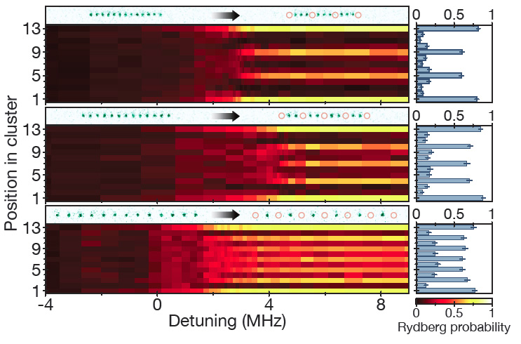
Rydberg Tweezers
→ Ising dynamics 30 particles (Orsay)
→ Topological order 14 particles (Orsay)
Labuhn et al., Nature 2016
→ 51 qubit quantum dynamics (Harvard)
de Léséleuc et al., Science 2019
→ 20 qubit GHZ states (Harvard)
→ MANY new experiments coming online
H. Bernien et al., Nature 2017

Slide 16
Outline
Quantum simulation platforms
→ Optical lattices, Rydberg tweezers, trapped ions
Variational ground states with 20 ions
3) Verification
4) Summary & Outlook

Slide 17
Trapped ions

Slide 18
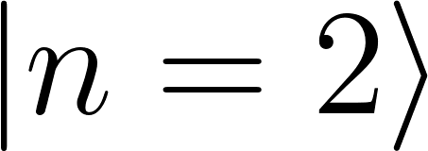
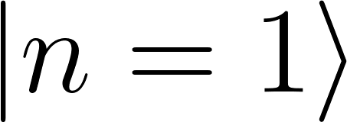
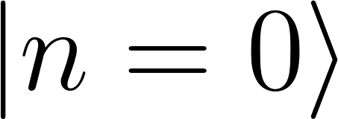
Trapped ions

Slide 19
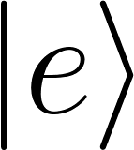
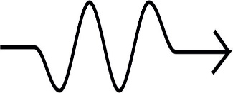
Trapped ions

Slide 20
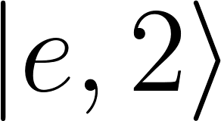
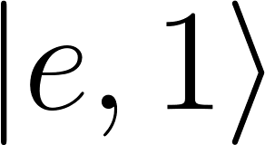
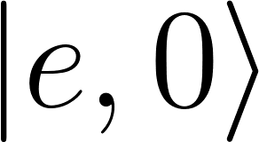
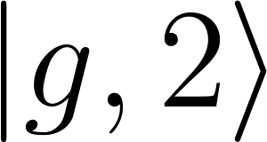
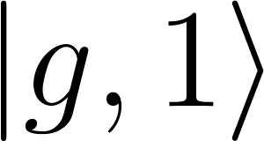
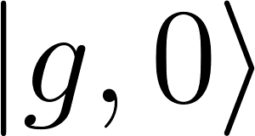
Trapped ions

Slide 21
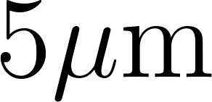
Trapped ions
Center of mass motion

Slide 22
Trapped ions
Cirac, Zoller, Phys. Rev. Lett. 74, 4091 (1995)

Slide 23
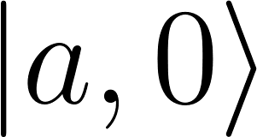
Trapped ions
Cirac, Zoller, Phys. Rev. Lett. 74, 4091 (1995)

Slide 24
Trapped ions
Cirac, Zoller, Phys. Rev. Lett. 74, 4091 (1995)

Slide 25
Trapped ions
Cirac, Zoller, Phys. Rev. Lett. 74, 4091 (1995)

Slide 26
Trapped ions
Center of mass motion
Cirac, Zoller, Phys. Rev. Lett. 74, 4091 (1995)

Slide 27
Trapped ions
→ More advanced schemes exist (e.g. Molmer Sorensen)
→ Entanglement propagated via collective motion (“phonon bus”)
→ Illuminating all ions at once: exchange interaction

Slide 28
Trapped ions
→ More advanced schemes exist (e.g. Molmer Sorensen)
→ Entanglement propagated via collective motion (“phonon bus”)
→ Illuminating all ions at once: exchange interaction
→ Realises quantum simulation of long-range Ising model

Slide 29
Ion traps: current state of the art
Qubits: ~ 10 - 50 ions (full connectivity)
Fidelities: initialisation: 99.9%
gates: 99.5%
readout: 99.9..%
Speed: kHz ~ MHz
Scalability: up to 100’s of ions in single trap (naturally identical)
optical control → modular networks with optical links
Fidelities:
- initialisation: 99.9%
- gates: 99.5%
- readout: 99.9%
Highlights: QEC, topological encoding (Innsbruck),
Quantum Simulations, 20 - 50 ions (Innsbruck, Maryland, NIST)
Shor, GHZ states (Innsbruck), Microfabricated ion-traps (Sandia, NPL, ...)
Integration, light delivery (MIT LL), readout (NIST), networks (Oxford),
‘best 11 qubit quantum computer’ (Maryland, arXiv:1903.08181) ….

Slide 30
Outline
Quantum simulation platforms
→ Optical lattices, Rydberg tweezers, ion traps
Variational ground states with 20 ions
3) Verification
4) Summary & Outlook

Slide 31
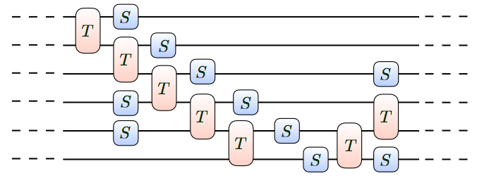
Quantum Simulation
X
(fermions, Rydbergs, ions)
→ Analog quantum simulation
→ Digital quantum simulation
Trotterised time evolution:
Trapped ions: Blatt, Monroe, Schmidt-Kaler..
Martinez, Muschik et al., Nature 2016

Slide 32
Quantum Simulation
X
→ Analog quantum simulation
→ Digital quantum simulation
→ Variational quantum simulation
‘QPU’
Q. Chem.
Peruzzo et al., N. Comm. 5, 4213
QAOA
Farhi et al., arXiv 1411.4028
McClean et al., NJP 18 023023
Kandala et al., Nature 2017, Hempel et al. PRX 2018

Slide 33
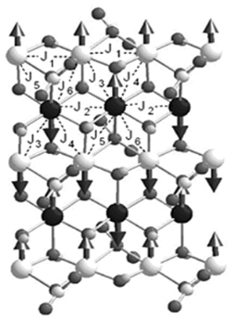
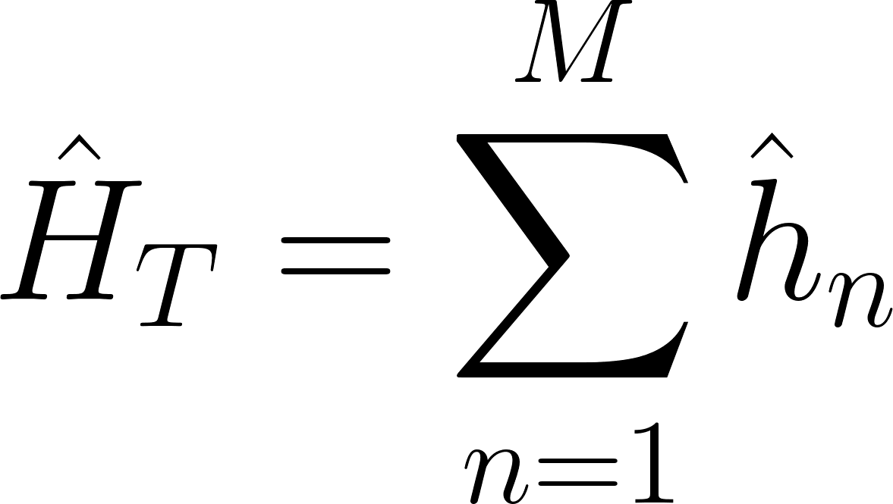
Variational Quantum Simulation
Target (virtual)
Quantum Resource (QPU)
spin Hamiltonian
→ sums of Pauli products:

Slide 34
Programmable Quantum Simulators
Build ‘circuits’:
- Ising interactions (entangling)
- Single particle rotations

Slide 35
Programmable Quantum Simulators
Build ‘circuits’:
- Ising interactions (entangling)
- Single particle rotations

Slide 36
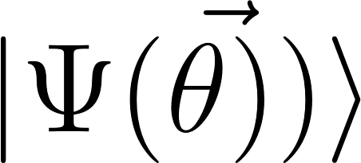
Programmable Quantum Simulators
Build ‘circuits’:
- Ising interactions (entangling)
- Single particle rotations
‘programmable’

Slide 37
Variational Quantum Simulation
Target (virtual)
Quantum Resource (QPU)
spin Hamiltonian
→ sums of Pauli products:
“Programmable Analog Quantum Simulator”

Slide 38
Variational Quantum Simulation
The goal of Variational Quantum Simulation
Prepare ground state of by minimising
measurements
Farhi et al.. arXiv:1411.4028 (2014).
McClean, et al. New Journal of Physics (2016): 023023

Slide 39
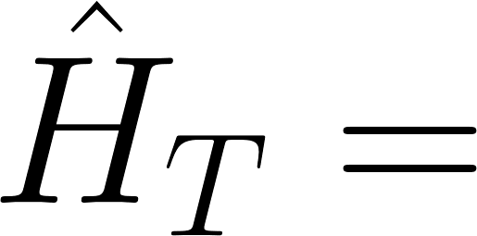
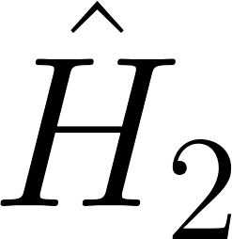
Variational Quantum Simulation
-1
-1
-1
-1
+1
+1
-1
-1
-1
+1
-1
-1
+1
+1
+1
+1
+1
+1
-1
-1
-1
+1
+1
-1
-1
-1
+1
+1
+1
+1
+1
-1
The goal of Variational Quantum Simulation
What is for a given parameter vector ?
Repetitions for expectation value
Prepare ground state of by minimising
measurements
Farhi et al.. arXiv:1411.4028 (2014).
McClean, et al. New Journal of Physics (2016): 023023

Slide 40
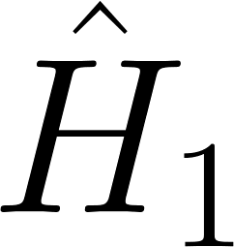
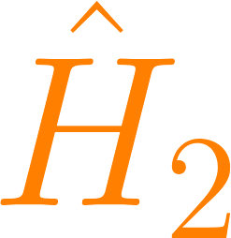
Variational Quantum Simulation
-1
-1
-1
+1
-1
-1
+1
+1
What is for a given parameter vector ?
Repetitions for expectation value
measurements
Expectation value for one point in parameter space
Farhi et al.. arXiv:1411.4028 (2014).
McClean, et al. New Journal of Physics (2016): 023023

Slide 41
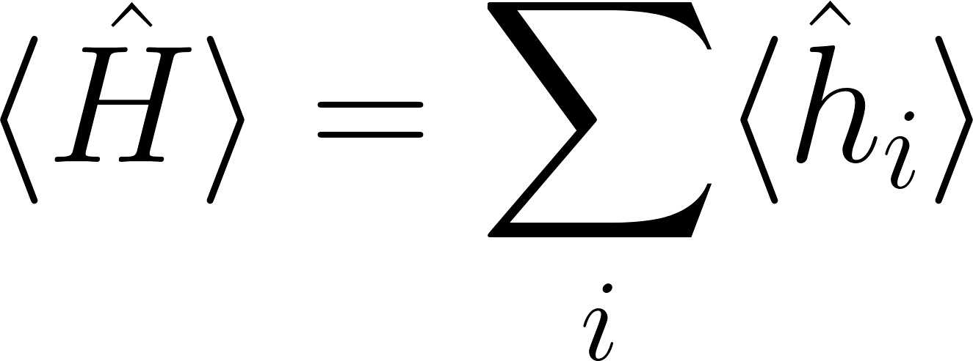
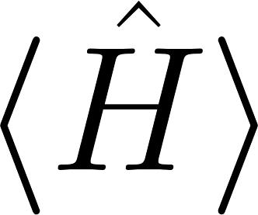
Ultrabrief summary
in:
Quantum system produces
No need to realise Hamiltonian → flexible!
Uses whatever quantum resources available
out:
(incl. systematic errors, noise, ..)

Slide 42
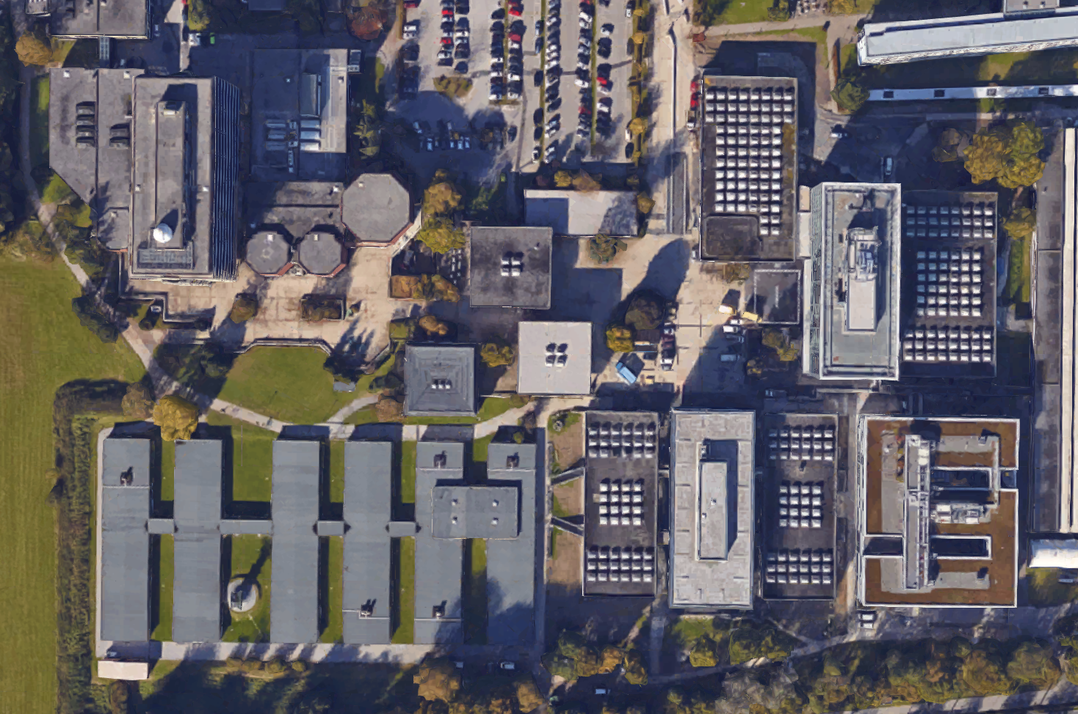
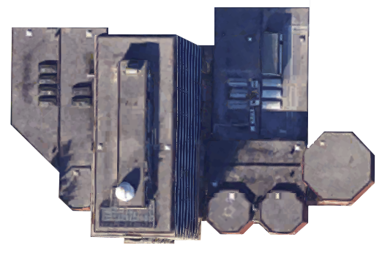
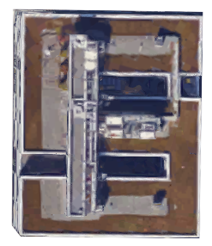
The Innsbruck Quantum Cloud
UIBK
IQOQI
https://www.google.at/maps/@47.2646691,11.3432391,17z

Slide 43
The Innsbruck Quantum Cloud
Digital Simulation
useQPU = False
useQPU = True
Analog Simulation

Slide 44
The Innsbruck Quantum Cloud
useQPU = False
useQPU = True
Analog Simulation

Slide 45
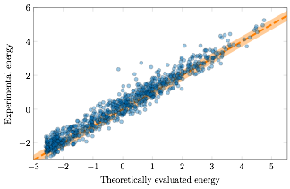
The Innsbruck Quantum Cloud
Theory-Experiment Correlation
Energy (measured)
59% of the data points are within the error band
Analog Simulation
Energy (simulated)

Slide 46
Variational Quantum Simulation
Target (virtual)
Quantum Resource (QPU)
spin Hamiltonian
→ sums of Pauli products

Slide 47
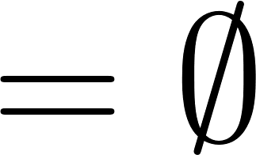
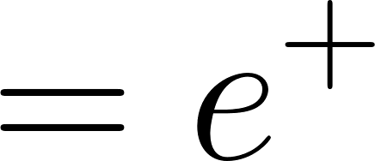
Target: Lattice Schwinger model
A model of quantum electrodynamics in 1D
Kogut-Susskind encoding
E. A. Martinez et al., Nature 534, 516 (2016)
C. Muschik et al., NJP 19, 103020 (2017)

Slide 48
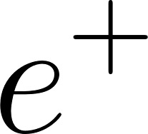
Target: Lattice Schwinger model
A model of quantum electrodynamics in 1D
Kogut-Susskind encoding
E. A. Martinez et al., Nature 534, 516 (2016)
C. Muschik et al., NJP 19, 103020 (2017)

Slide 49
Target: Lattice Schwinger model
A model of quantum electrodynamics in 1D
Kogut-Susskind encoding
Important Symmetries of the Model
E. A. Martinez et al., Nature 534, 516 (2016)
C. Muschik et al., NJP 19, 103020 (2017)

Slide 50
Variational Quantum Simulation
Target (virtual)
Quantum Resource (QPU)
spin Hamiltonian
→ sums of Pauli products

Slide 51
Variational Quantum Simulation
Target (virtual)
Quantum Resource (QPU)
spin Hamiltonian
→ sums of Pauli products

Slide 52
Classical Global Optimisation Algorithm
Global optimisation problem with many local minima
Very noisy problem
We cannot use gradients
→ DIviding RECTangles (DIRECT)
global optimisation algorithm
Jones et.al. Lipschitzian optimization without the Lipschitz constant. Journal of Optimization Theory and Applications, 79(1), 157-181. (1993)

Slide 53
Classical Global Optimisation Algorithm
Sampling point represents region in param. space
Jones et.al. Lipschitzian optimization without the Lipschitz constant. Journal of Optimization Theory and Applications, 79(1), 157-181. (1993)

Slide 54
Classical Global Optimisation Algorithm
Identifying potentially optimal hyperrectangles:
Sampling point represents region in param. space
cost function value
Hyperrect. size
Jones et.al. Lipschitzian optimization without the Lipschitz constant. Journal of Optimization Theory and Applications, 79(1), 157-181. (1993)

Slide 55
Classical Global Optimisation Algorithm
Identifying potentially optimal hyperrectangles:
Sampling point represents region in param. space
cost function value
Hyperrect. size
Jones et.al. Lipschitzian optimization without the Lipschitz constant. Journal of Optimization Theory and Applications, 79(1), 157-181. (1993)

Slide 56
Classical Global Optimisation Algorithm
Identifying potentially optimal hyperrectangles:
Sampling point represents region in param. space
cost function value
Hyperrect. size
Jones et.al. Lipschitzian optimization without the Lipschitz constant. Journal of Optimization Theory and Applications, 79(1), 157-181. (1993)

Slide 57
Classical Global Optimisation Algorithm
Identifying potentially optimal hyperrectangles:
Sampling point represents region in param. space
cost function value
Hyperrect. size
Jones et.al. Lipschitzian optimization without the Lipschitz constant. Journal of Optimization Theory and Applications, 79(1), 157-181. (1993)

Slide 58
Classical Global Optimisation Algorithm
Identifying potentially optimal hyperrectangles:
Sampling point represents region in param. space
cost function value
Hyperrect. size
Jones et.al. Lipschitzian optimization without the Lipschitz constant. Journal of Optimization Theory and Applications, 79(1), 157-181. (1993)

Slide 59
Classical Global Optimisation Algorithm
Identifying potentially optimal hyperrectangles:
Sampling point represents region in param. space
1 of the largest rectangles is
always added to the convex hull
cost function value
Hyperrect. size
Jones et.al. Lipschitzian optimization without the Lipschitz constant. Journal of Optimization Theory and Applications, 79(1), 157-181. (1993)

Slide 60
Variational Quantum Simulation
Target (virtual)
Quantum Resource (QPU)
spin Hamiltonian
→ sums of Pauli products

Slide 61
The Innsbruck Quantum Cloud
useQPU = True
Analog Simulation

Slide 62
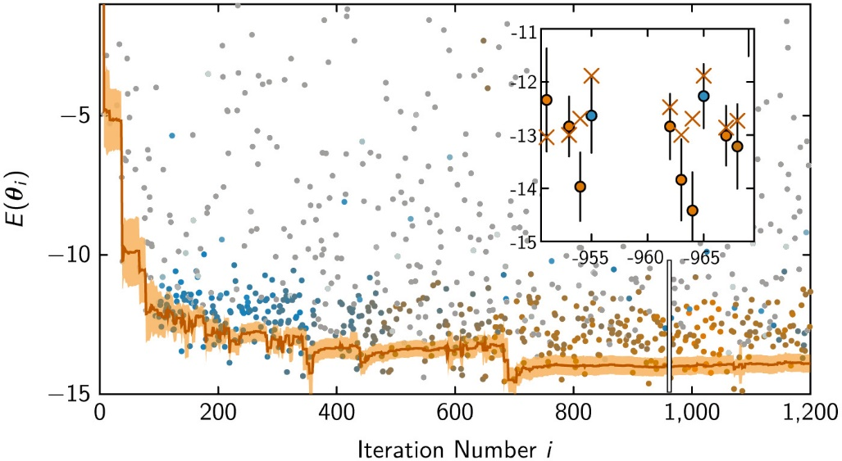
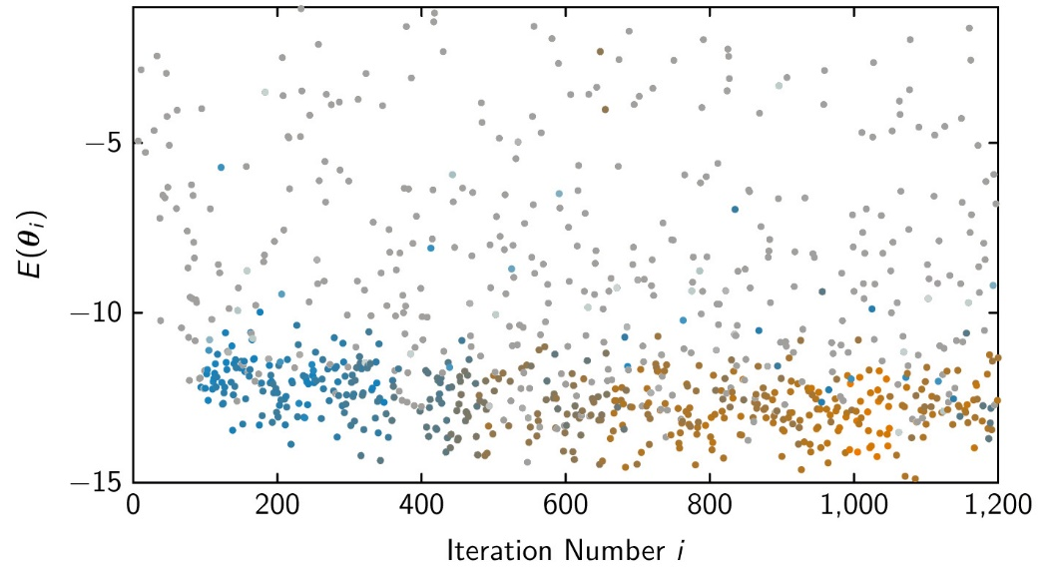
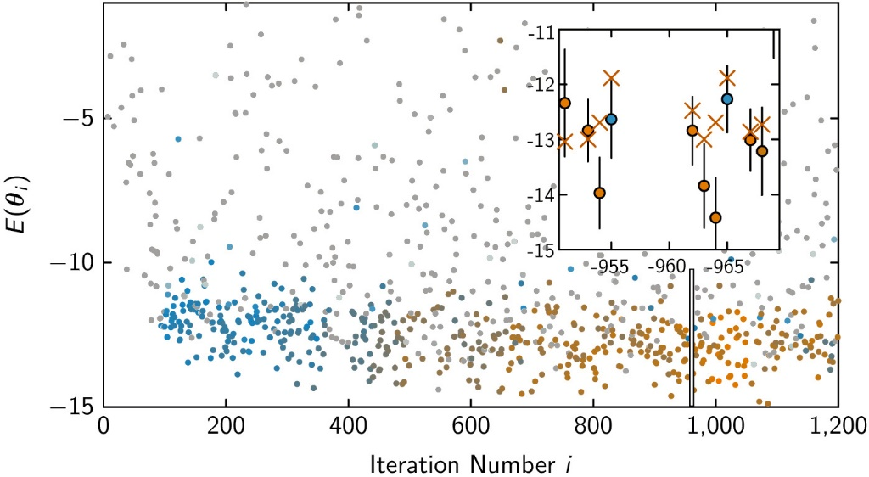
20 ion optimisation
useQPU = True
Quantum Circuit:
- 3 entanglers
- 3 x single particle rotations
- use bulk symmetry
on 12 central ions
→ 15 variational parameters
C. Kokail*, C. Maier*, RvB*, T. Brydges, M. Joshi, P. Jurcevic, C. Muschik, P. Silvi, R. Blatt, C.F. Roos, P. Zoller, Nature 569, 355 (2019)

Slide 63
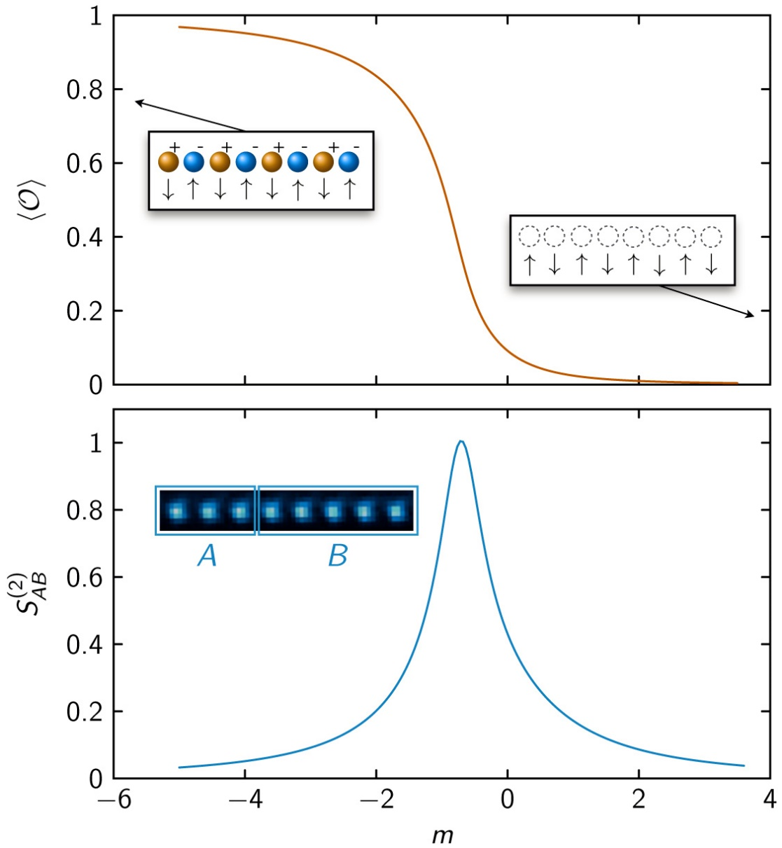
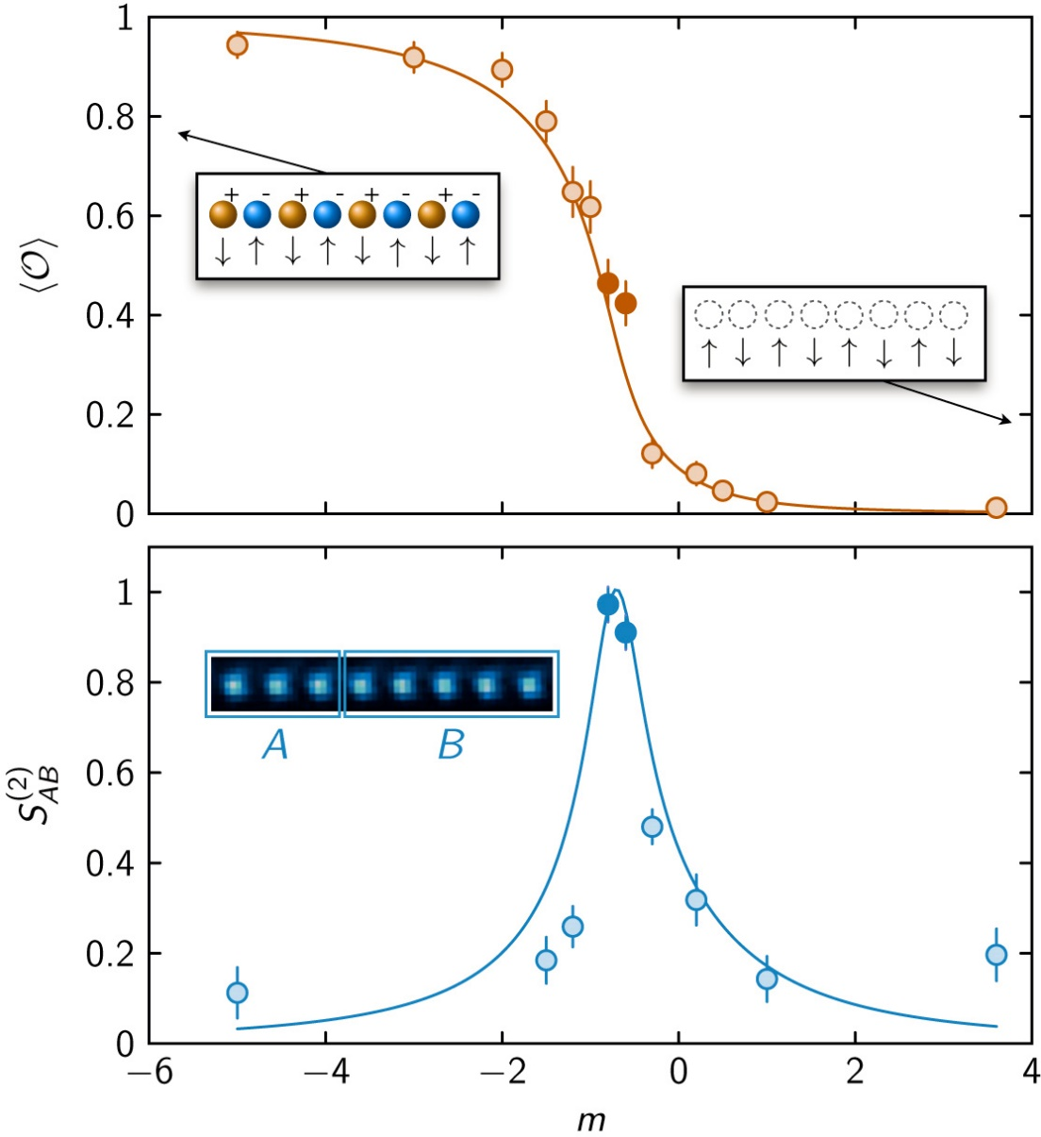
Variationally observing a phase transition (8 ions)
useQPU = True
( th. fidelities ~95% )
Quantum phase transition from CP-ordered to a disordered phase as a function of the bare mass
Order Parameter : Charge correlation function
mass m
Measure Renyi entropies:
T. Brydges, A. Elben et al., Science 364, 260–263 (2019).
A. Elben, B. Vermersch et al., PRL 120, 050406 (2018)
C. Kokail*, C. Maier*, RvB*, T. Brydges, M. Joshi, P. Jurcevic, C. Muschik, P. Silvi, R. Blatt, C.F. Roos, P. Zoller, Nature 569, 355 (2019)

Slide 64
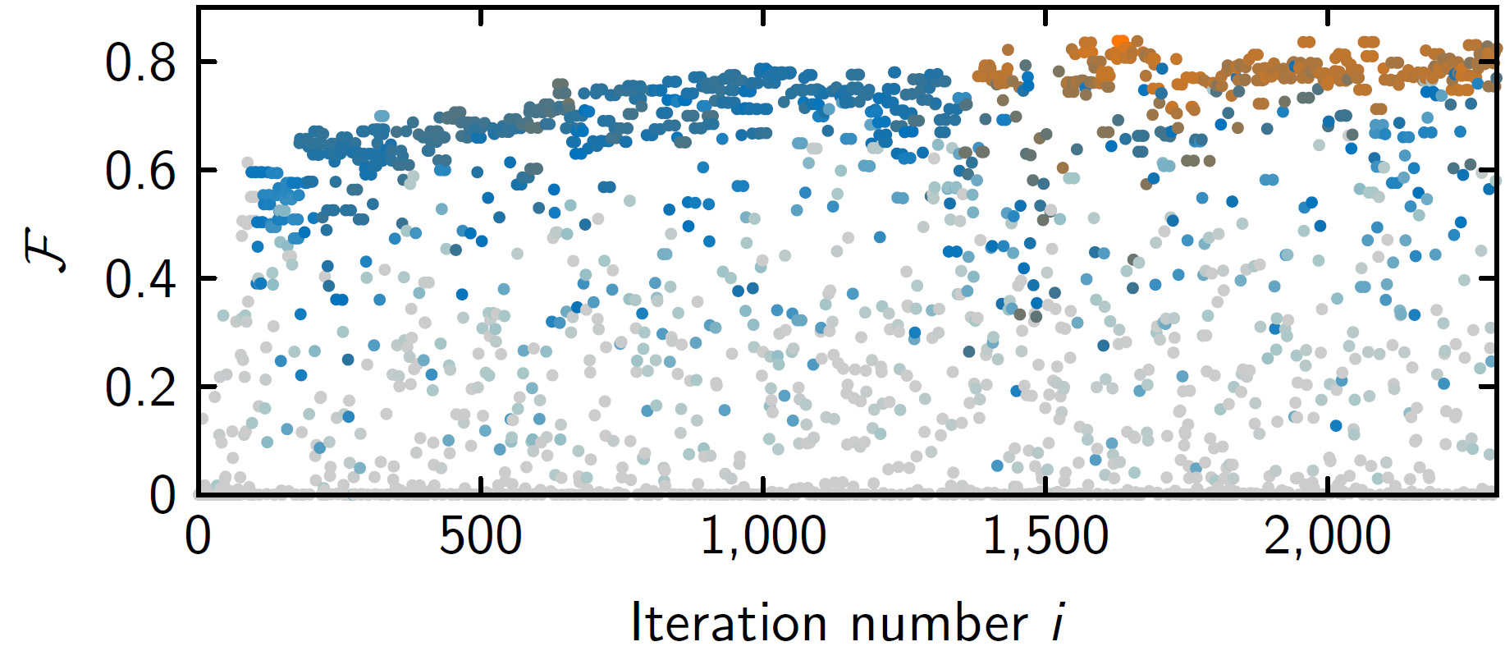
20 ion optimisation
useQPU = False
Reached ~85%
C. Kokail*, C. Maier*, RvB*, T. Brydges, M. Joshi, P. Jurcevic, C. Muschik, P. Silvi, R. Blatt, C.F. Roos, P. Zoller, Nature 569, 355 (2019)

Slide 65
Outline
Quantum simulation platforms
→ Optical lattices, Rydberg tweezers, ion traps
Variational ground States with 20 ions
3) Verification
4) Summary & Outlook

Slide 66
Verification
Target (virtual)
Quantum Resource (QPU)
spin Hamiltonian
→ sums of Pauli products

Slide 67
Verification
Target (virtual)
Quantum Resource (QPU)
spin Hamiltonian
→ sums of Pauli products
→ we can measure it

Slide 68
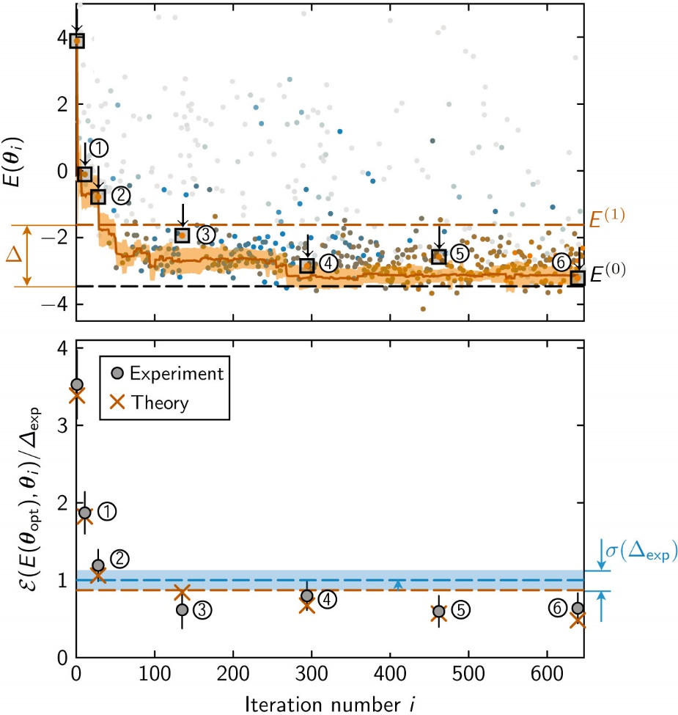
Verification (8 ions)
useQPU = True
( Th. fidelity ~95% )
Variance of the Schwinger Model:
measurements in different bases
0
300
600
Variance tells you how far away you are from an eigenstate
Iteration number
Measured on the device itself!
C. Kokail*, C. Maier*, RvB*, T. Brydges, M. Joshi, P. Jurcevic, C. Muschik, P. Silvi, R. Blatt, C.F. Roos, P. Zoller, Nature 569, 355 (2019)

Slide 69
Outline
Quantum simulation platforms
→ Optical lattices, Rydberg tweezers, ion traps
2) Variational ground states of 20 ions
3) Verification
4) Summary & Outlook

Slide 70
Conclusions & Outlook
Optical lattices, Rydbergs, ions …
Variational Quantum Simulation is an extremely flexible method for quantum simulation of lattice models
Uses whatever quantum resources available
Exploits high repetition rates: many measurements, but with short coherence time
Quantum simulation result can be verified by measuring variances
(likely) Scalable for interesting problems
Larger systems, 2D, ..
Other cost functions: Quantum metrology
C. Kokail*, C. Maier*, RvB*, T. Brydges, M. Joshi, P. Jurcevic, C. Muschik, P. Silvi, R. Blatt, C.F. Roos, P. Zoller, Nature 569, 355 (2019)

Slide 71
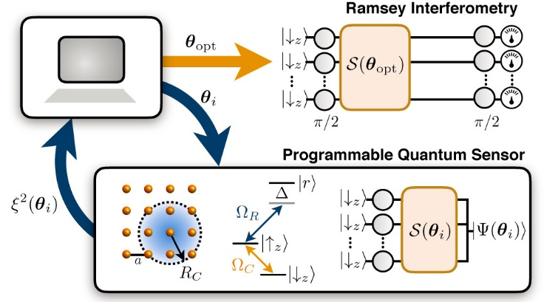
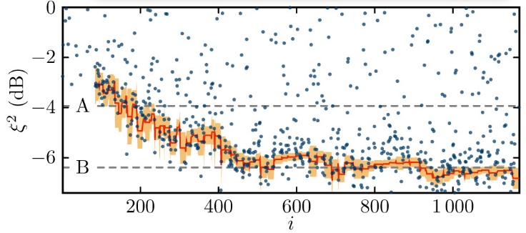
Programmable Quantum Sensors
R. Kaubruegger et al., arXiv:1908.08343 (accepted Phys. Rev. Lett.)

Slide 72
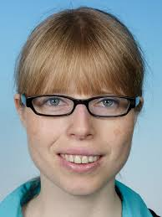
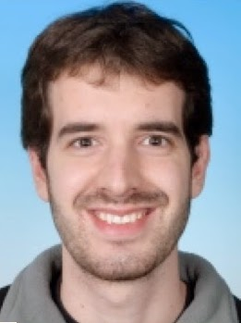
Innsbruck Quantum Cloud
Digital Simulation
C. Muschik
E. Martinez
R. Blatt
C. Maier
T. Monz
P. Schindler
R. Stricker
P. Silvi
C. Kokail
C. Roos
P. Jurcevic
P. Zoller
M. Joshi
T. Brydges

Slide 73
Variational Quantum Simulation
Target (virtual)
Quantum Resource (QPU)
spin Hamiltonian
→ sums of Pauli products

Slide 74
Quantum Resource: Trapped ions
By coupling to different vibrational modes one can implement a long-range
Spin-Spin Interaction Hamiltonian
Single Qubit rotations on the Bloch sphere

Slide 75
Matching symmetries
Target Schwinger model symmetries: magnetisation + CP ( + bulk )
search space
X
Hilbert space

Slide 76
Matching symmetries
Target Schwinger model symmetries: magnetisation + CP ( + bulk )
Quanum Resource:
search space
X
→ set:
Hilbert space
Spin-Spin Interaction Hamiltonian

Slide 77
Scaling?

Slide 78
Scaling?
Lattice models:

Slide 79
Scaling?
Random Hamiltonians:

